Slide 1
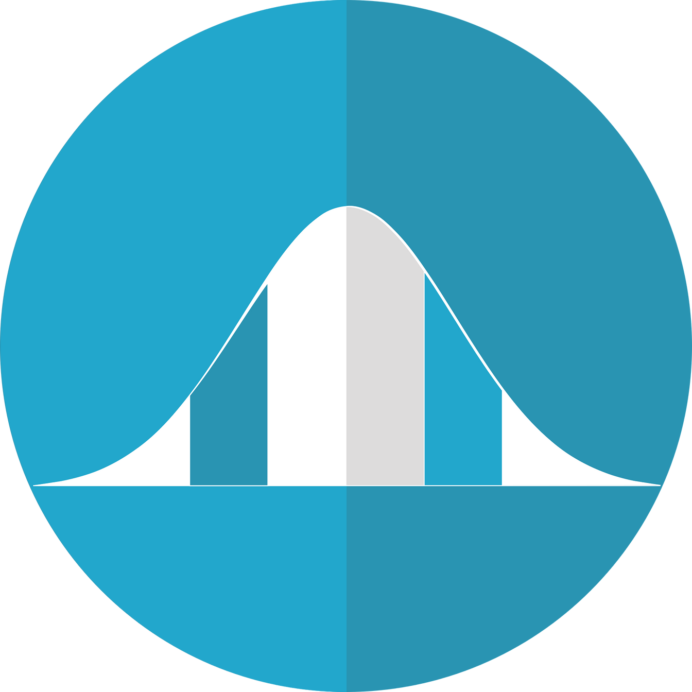

UNDERSTANDING THE NORMAL DISTRIBUTION
Notes:
Welcome! In this video, we’ll explore one of the most important ideas in statistics: the normal distribution.
Even if you’ve never seen a bell curve before, by the end of this lesson you’ll understand what it is, how it works, and why it matters in both academic research and everyday decisions.

Slide 2

LEARNING OBJECTIVES
Describe the key characteristics of a normal distribution
Explain the meaning of standard deviation in the context of this lesson
Apply the 68–95–99.7 rule to interpret data
Recognize real-life examples of normally distributed variables
Identify when data is not normally distributed
Notes:
Before we begin, here’s what you’ll be able to do by the end of this lesson:
Describe the key characteristics of a normal distribution: what it looks like and what makes it unique.
Understand how standard deviation helps measure the spread of data on a bell curve.
Apply the 68–95–99.7 rule to interpret where most values fall in a normal distribution.
Recognize real-life examples where the normal distribution naturally occurs, such as test scores or human height.
Identify when data may not follow a normal distribution and what to do about it.

Slide 3
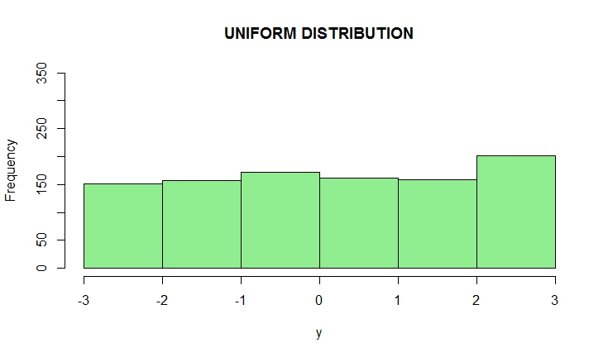
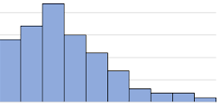
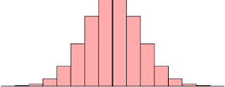
WHAT IS A DISTRIBUTION?
A distribution shows how data is spread across values.
Note: Some distributions are uniform, some are skewed, and some—like the normal distribution—are symmetrical.
Notes:
Let’s start with a quick definition. In statistics, a distribution shows how values are spread across a dataset.
Some distributions are uniform, where each value is equally likely.
Others are skewed, with most values leaning toward one side.
A symmetrical distribution is balanced on both sides of the center.
The normal distribution is a perfect example of symmetry, which is one reason it’s so widely used. We’ll look at some examples of symmetrical distributions shortly.
But just as a quick example of the other two:
Rolling a die produces a uniform distribution.
Household income often follows a skewed distribution—most people earn moderate amounts, but a few earn extremely high incomes that stretch the tail to the right.

Slide 4
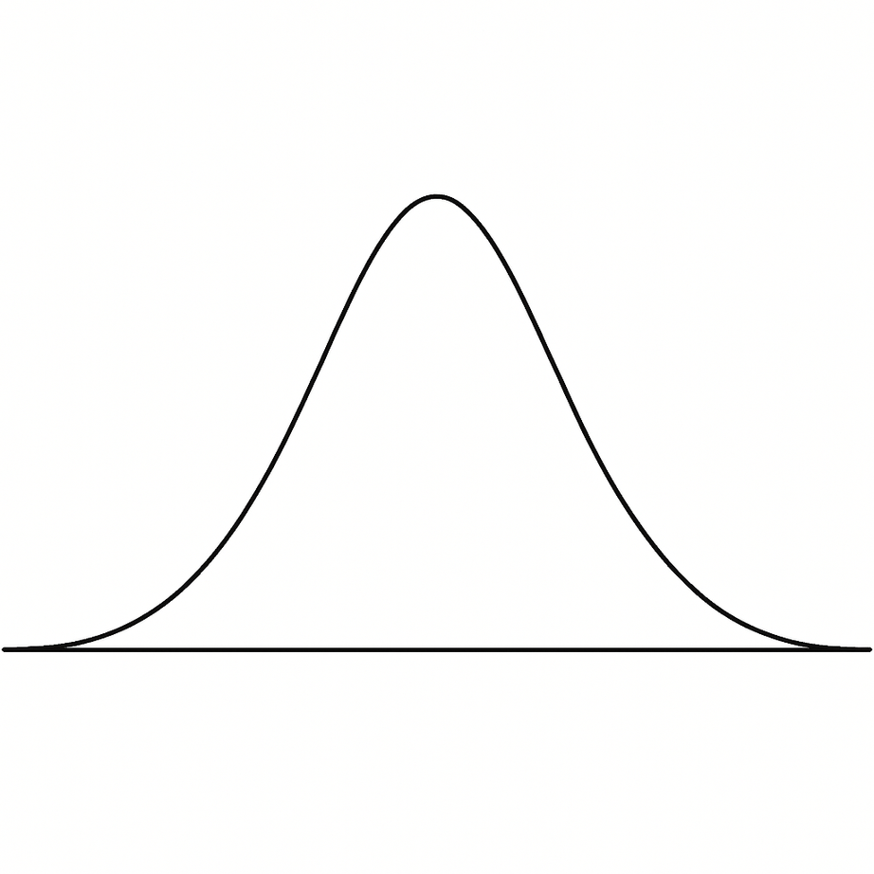
MEET THE BELL CURVE
SINGLE PEAK
REFRESHER ON TERMS
Mean – The average of all values
Median – The middle number when values are ordered
Mode – The most frequent value
MEAN = MEDIAN = MODE
SYMMETRICAL
Notes:
This is the classic bell curve, also known as the normal distribution. It’s perfectly symmetrical, with a single peak in the center. The highest point marks the mean, which is the average value of the dataset.
A quick refresher:
Mean: the average of all values
Median: the middle value when the data is sorted
Mode: the most frequently occurring value
In a normal distribution, all three align at the center, making it a powerful model for data that clusters around an average.

Slide 5



REAL-LIFE EXAMPLES
Human Height
IQ Scores
SAT Scores
MOST PEOPLE ARE NEAR THE AVERAGE. FEW ARE AT THE EXTREMES.
Notes:
So, where does the normal distribution show up in real life?
Human height: Most people are near the average, with fewer very short or very tall individuals.
IQ scores: Designed to have a mean of 100, with most scores clustering near that point.
Standardized tests like the SAT or ACT: Built to follow a normal curve for fairness.
Even things like blood pressure or shoe sizes often follow a bell-shaped pattern.
These examples show how the normal distribution helps us understand what’s typical and what’s unusual.

Slide 6
STANDARD DEVIATION
-3σ
-2σ
-1σ
μ
1σ
2σ
3σ
In a normal distribution, μ is the mean and σ shows the spread around it.
Notes:
Now let’s talk about standard deviation, represented by the Greek letter sigma (σ). It tells us how spread out the data is from the mean (μ).
In a normal distribution:
A small σ means values are tightly clustered around the mean.
A large σ means values are more spread out.
For example, two classes might both have an average test score of 80, but one class might have scores between 75 and 85, while the other ranges from 60 to 100. That’s the difference standard deviation captures.

Slide 7
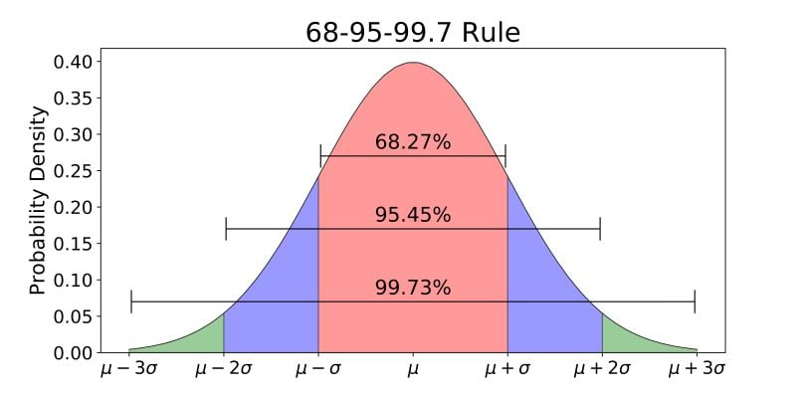
68–95–99.7 RULE
68% of data is within 1 standard deviation
95% within 2 standard deviations
99.7% within 3 standard deviations
Notes:
This rule describes how data falls within standard deviations of the mean:
68% of values fall within 1 standard deviation
95% fall within 2 standard deviations
99.7% fall within 3 standard deviations
Let’s say the average test score is 70 with a standard deviation of 10:
68% of students scored between 60 and 80
95% scored between 50 and 90
Nearly everyone scored between 40 and 100
This rule helps us quickly estimate probabilities and understand how common or rare a value is.

Slide 8




WHY IT MATTERS
Interpreting standardized scores
Hypothesis testing
Healthcare
Detecting outliers
Notes:
So, why is this important? Because the normal distribution helps us:
Identify outliers
Calculate probabilities
Make decisions about performance, quality, and fairness
It’s used in education, healthcare, psychology, economics, and more. If you’ve ever seen a grading curve or read about average blood pressure, you’ve seen the normal distribution at work.
In short, the normal distribution helps us make sense of the world through data.

Slide 9
BEFORE YOU ASSUME IT’S NORMAL…
Not all bell-shaped curves are truly normal
Real-world data is often skewed, categorical, etc.
The 68-95-99.7 rule only applies to normal distributions
T-distributions and others may look similar but behave differently
Notes:
A bell-shaped curve doesn’t always mean you’re looking at a true normal distribution.
In real life, data can be skewed, categorical, or have other patterns that don’t follow the normal model. The 68–95–99.7 rule only works for data that truly follows a normal distribution.
Some curves, like t-distributions, may look similar but behave differently—especially in the tails.

Slide 10
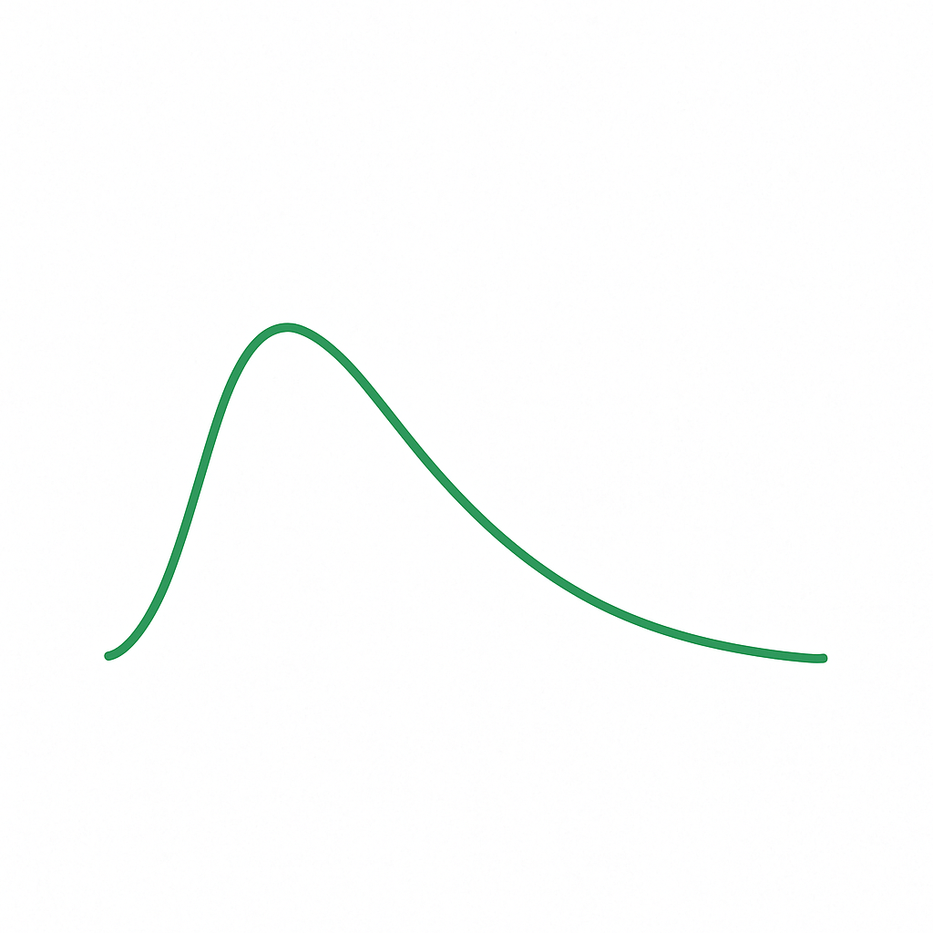
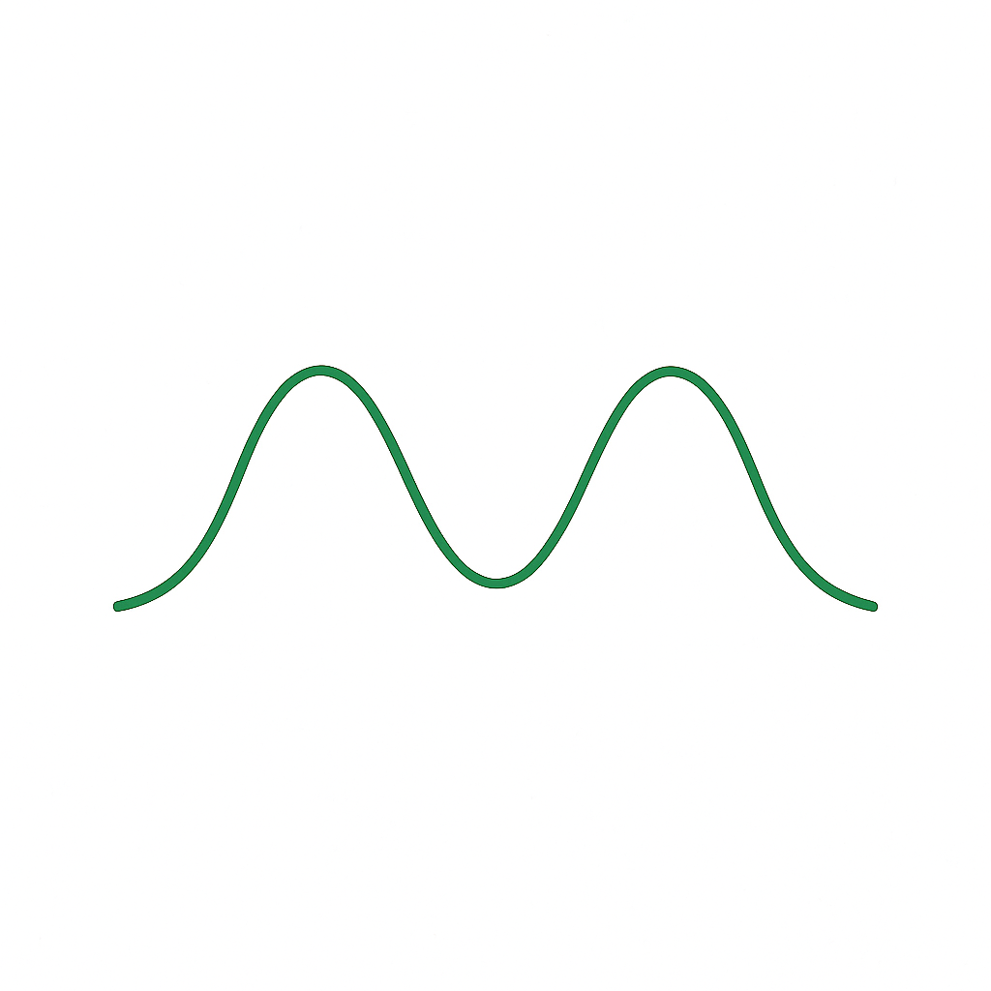

WHEN THE DATA ISN’T NORMAL
Right-skewed
Left-skewed
Bimodal
Uniform
Some options: non-parametric tests, data transformations, visual analysis tools
Notes:
Sometimes data doesn’t follow a perfect bell curve.
It might be skewed—meaning one side stretches out—or it might have more than one peak. It could even be uniform, with values spread evenly across a range. That’s why statisticians use different tools when normality doesn’t apply.
You can run non-parametric tests, which don’t rely on assumptions about the data’s shape, or try a data transformation (like taking the log or square root) to help the data look more balanced. Visual analysis tools—such as histograms or curve plots—can help you spot patterns and decide your next step.
The key idea: not all data is normal—and that’s perfectly fine. The important thing is recognizing the shape of your data and choosing the right method to analyze it.

Slide 11
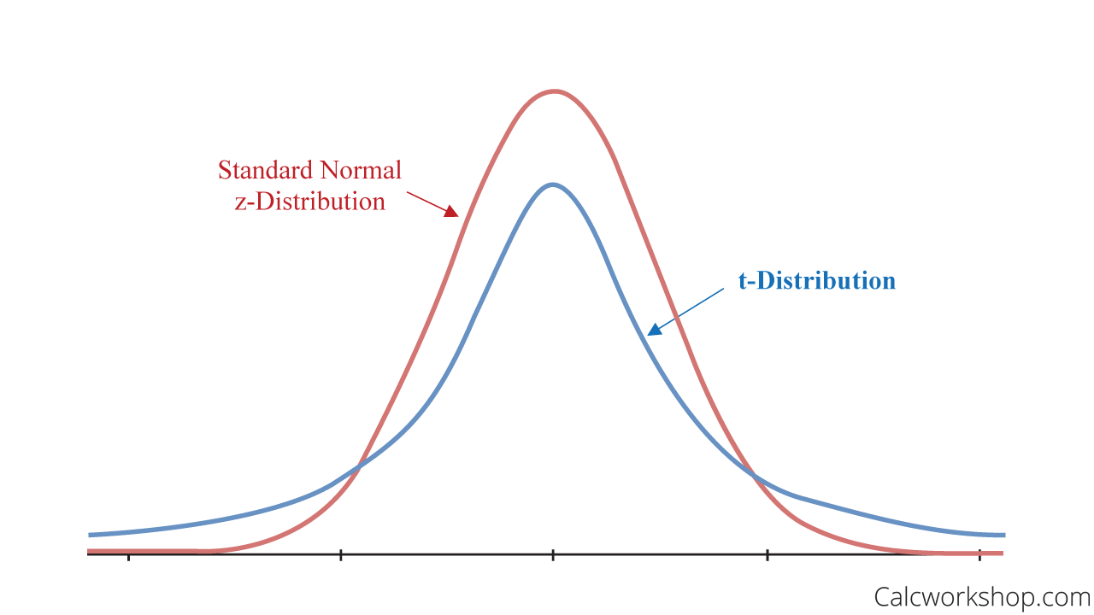
WHEN THE DATA IS APPROXIMATELY NORMAL
The t-distribution
Use the t-distribution for small samples
Similar to the normal curve, but with thicker tails
Becomes more normal as sample size grows
Notes:
When data isn’t perfectly normal but still roughly symmetrical, we don’t have to give up on using powerful statistical tools.
The t-distribution is designed for just this situation. It’s similar in shape to the normal curve but has slightly thicker tails, which helps account for the uncertainty we have when sample sizes are small or when we don’t know the population standard deviation.
As sample size increases, the t-distribution becomes nearly indistinguishable from the normal curve—so it bridges the gap nicely between small, uncertain datasets and more robust ones.

Slide 12
PRACTICAL EXAMPLE USING THE NORMAL DISTRIBUTION
68–95–99.7 RULE
μ = 30 minutes
σ = 10 minutes
Q: What range covers about 95% of commute times?
A: Between 10 and 50 minutes
Notes:
Let’s try a quick example:
Suppose the average commute time for workers in a city is 30 minutes, with a standard deviation of 10 minutes.
Using the 68–95–99.7 rule, what range covers about 95% of commute times?
Answer: From 10 to 50 minutes — that’s two standard deviations below and above the mean.
So, about 95% of workers in that city have a daily commute between 10 and 50 minutes, which helps planners understand what’s typical.

Slide 13


FINAL RECAP
Symmetrical, bell-shaped curve
Mean = median = mode
Standard deviation controls spread
The 68–95–99.7 Rule helps with probability
The normal distribution helps us make sense of data in education, health, research, business, etc.
Powerful, but not universal
Notes:
Key takeaways:
The normal distribution is symmetrical and bell-shaped
The mean, median, and mode are all at the center
Standard deviation shows how spread out values are
The 68–95–99.7 rule helps you understand probabilities
It’s used widely in education, health, research, and business
It’s powerful, but not universal. Some data isn’t normal, and that’s okay

Slide 14
THANKS FOR WATCHING!
Notes:
Thank you for watching!
This lesson on the normal distribution is just one small step in mastering statistics, but it’s a foundational one.

